Slide 1
COT5615: Math for Intelligent Systems I
Anand Rangarajan
Lecture 36

Slide 2
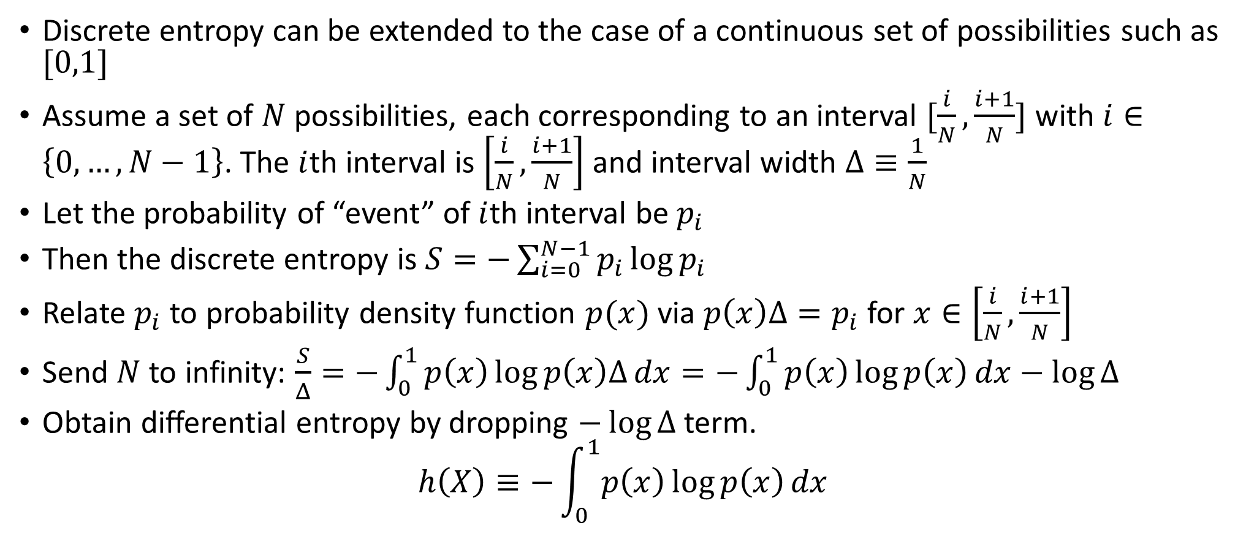
Differential Entropy
Discrete entropy can be extended to the case of a continuous set of possibilities such as $[0,1]$
Assume a set of $N$ possibilities, each corresponding to an interval $[\frac{i}{N},\frac{i+1}{N}]$ with $i∈\left\{0,…,N−1\right\}$. The $i$th interval is $\left[\frac{i}{N},\frac{i+1}{N}\right]$ and interval width $Δ≡\frac{1}{N}$
Let the probability of “event” of $i$th interval be $p_{i}$
Then the discrete entropy is $S=−\sum_{i=0}^{N−1}{p_{i}\log{p_{i}}}$
Relate $p_{i}$ to probability density function $p(x)$ via $p\left(x\right)Δ=p_{i}$ for $x∈\left[\frac{i}{N},\frac{i+1}{N}\right]$
Send $N$ to infinity: $\frac{S}{Δ}=−\int_{0}^{1}{p\left(x\right)\log{p\left(x\right)Δ}dx}=−\int_{0}^{1}{p\left(x\right)\log{p\left(x\right)}dx}−\log{Δ}$
Obtain differential entropy by dropping $−\log{Δ}$ term.
$$h\left(X\right)≡−\int_{0}^{1}{p\left(x\right)\log{p\left(x\right)}dx}$$

Slide 3
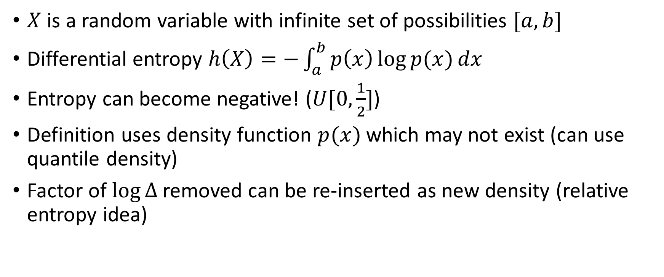
Problems of the definition
$X$ is a random variable with infinite set of possibilities $[a,b]$
Differential entropy $h\left(X\right)=−\int_{a}^{b}{p\left(x\right)\log{p(x)}dx}$
Entropy can become negative! ($U[0,\frac{1}{2}]$)
Definition uses density function $p(x)$ which may not exist (can use quantile density)
Factor of $\log{Δ}$ removed can be re-inserted as new density (relative entropy idea)

Slide 4
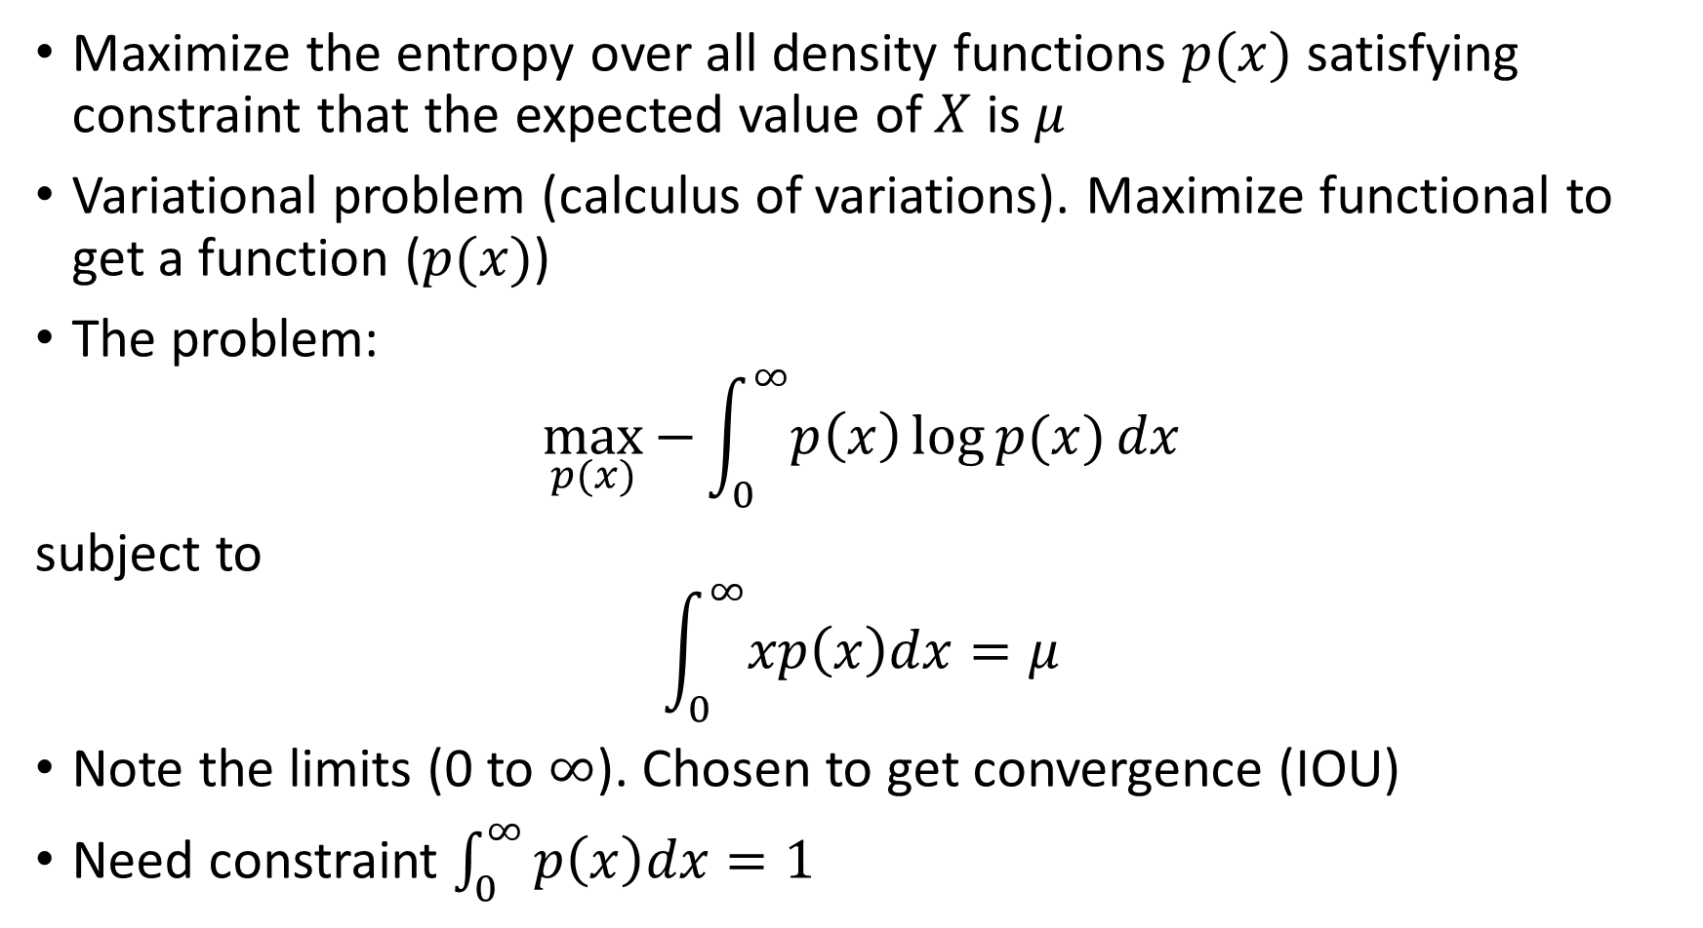
Maximizing the differential entropy
Maximize the entropy over all density functions $p(x)$ satisfying constraint that the expected value of $X$ is $μ$
Variational problem (calculus of variations). Maximize functional to get a function ($p(x)$)
The problem:
$$\max_{p(x)}{−\int_{0}^{∞}{p\left(x\right)\log{p(x)}}dx}$$
subject to
$$\int_{0}^{∞}{xp\left(x\right)dx}=μ$$
Note the limits (0 to $∞$). Chosen to get convergence (IOU)
Need constraint $\int_{0}^{∞}{p\left(x\right)dx}=1$

Slide 5
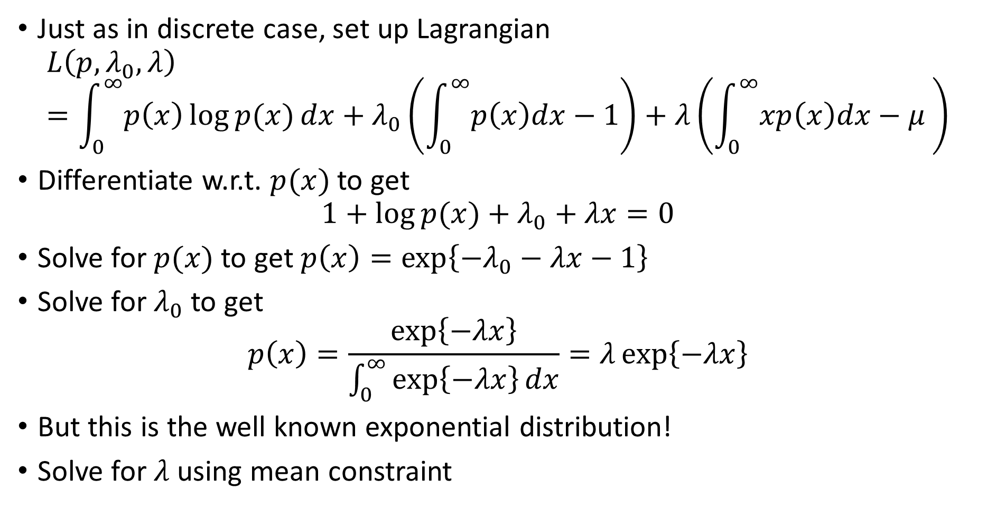
Maximizing the differential entropy (contd.)
Just as in discrete case, set up Lagrangian
$$L\left(p,λ_{0},λ\right)=\int_{0}^{∞}{p\left(x\right)\log{p(x)}}dx+λ_{0}\left(\int_{0}^{∞}{p\left(x\right)dx}−1\right)+λ\left(\int_{0}^{∞}{xp\left(x\right)dx}−μ \right)$$
Differentiate w.r.t. $p(x)$ to get
$$1+\log{p(x)}+λ_{0}+λx=0$$
Solve for $p(x)$ to get $p\left(x\right)=\exp\left\{−λ_{0}−λx−1\right\}$
Solve for $λ_{0}$ to get
$$p\left(x\right)=\frac{\exp\left\{−λx\right\}}{\int_{0}^{∞}{\exp\left\{−λx\right\}dx}}=λ\exp\left\{−λx\right\}$$
But this is the well known exponential distribution!
Solve for $λ$ using mean constraint

Slide 6
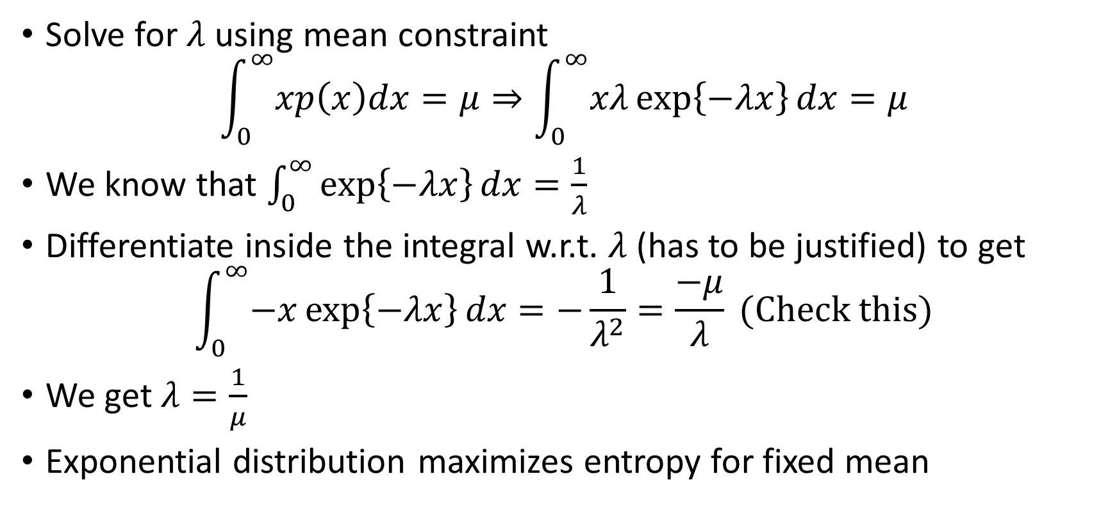
Maximizing the differential entropy (fini)
Solve for $λ$ using mean constraint
$$\int_{0}^{∞}{xp\left(x\right)dx}=μ⇒\int_{0}^{∞}{xλ\exp\left\{−λx\right\}dx}=μ$$
We know that $\int_{0}^{∞}{\exp\left\{−λx\right\}dx}=\frac{1}{λ}$
Differentiate inside the integral w.r.t. $λ$ (has to be justified) to get
$$\int_{0}^{∞}{−x}\exp\left\{−λx\right\}dx=−\frac{1}{λ^{2}}=\frac{−μ}{λ} (Check this)$$
We get $λ=\frac{1}{μ}$
Exponential distribution maximizes entropy for fixed mean

Slide 7
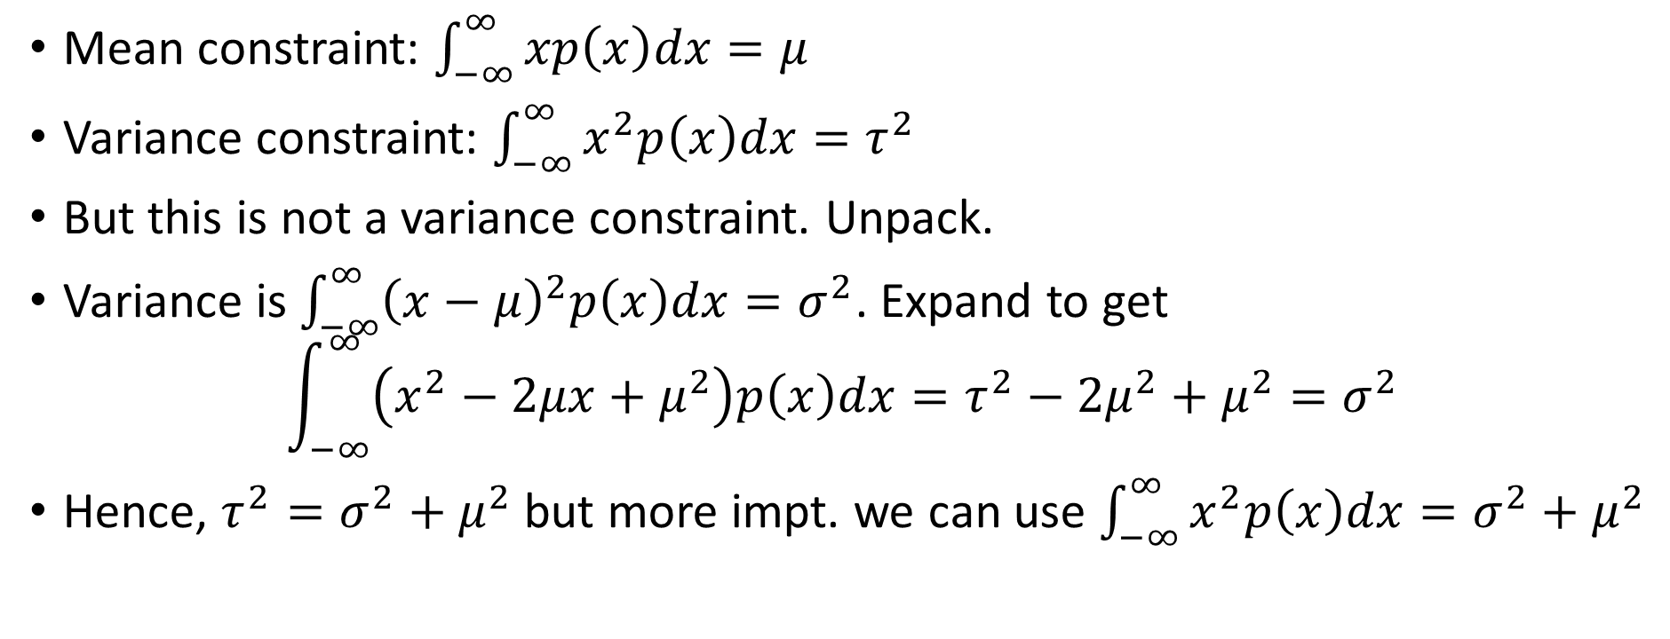
What about fixed mean and variance?
Mean constraint: $\int_{−∞}^{∞}{xp\left(x\right)dx}=μ$
Variance constraint: $\int_{−∞}^{∞}{x^{2}p\left(x\right)dx}=τ^{2}$
But this is not a variance constraint. Unpack.
Variance is $\int_{−∞}^{∞}{{\left(x−μ\right)}^{2}p\left(x\right)dx}=σ^{2}$. Expand to get
$$\int_{−∞}^{∞}{\left(x^{2}−2μx+μ^{2}\right)p\left(x\right)dx}=τ^{2}−2μ^{2}+μ^{2}=σ^{2}$$
Hence, $τ^{2}=σ^{2}+μ^{2}$ but more impt. we can use $\int_{−∞}^{∞}{x^{2}p\left(x\right)dx}=σ^{2}+μ^{2}$

Slide 8
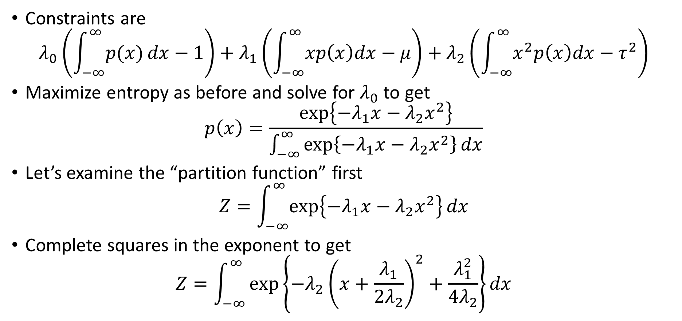
Mean and Variance constraints
Constraints are
$$λ_{0}\left(\int_{−∞}^{∞}{p(x)}dx−1\right)+λ_{1}\left(\int_{−∞}^{∞}{xp\left(x\right)dx}−μ\right)+λ_{2}\left(\int_{−∞}^{∞}{x^{2}p\left(x\right)dx}−τ^{2}\right)$$
Maximize entropy as before and solve for $λ_{0}$ to get
$$p\left(x\right)=\frac{\exp\left\{−λ_{1}x−λ_{2}x^{2}\right\}}{\int_{−∞}^{∞}{\exp\left\{−λ_{1}x−λ_{2}x^{2}\right\}}dx}$$
Let’s examine the “partition function” first
$$Z=\int_{−∞}^{∞}{\exp\left\{−λ_{1}x−λ_{2}x^{2}\right\}}dx$$
Complete squares in the exponent to get
$$Z=\int_{−∞}^{∞}{\exp\left\{−λ_{2}{\left(x+\frac{λ_{1}}{2λ_{2}}\right)}^{2}+\frac{λ_{1}^{2}}{4λ_{2}}\right\}}dx$$

Slide 9
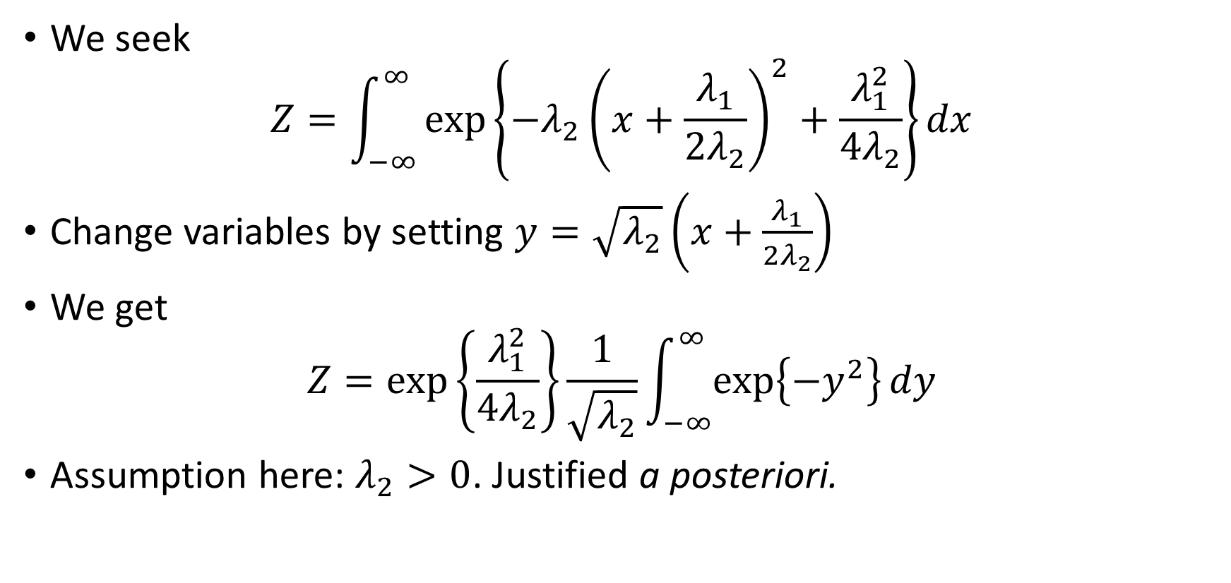
The Partition Function (contd.)
We seek
$$Z=\int_{−∞}^{∞}{\exp\left\{−λ_{2}{\left(x+\frac{λ_{1}}{2λ_{2}}\right)}^{2}+\frac{λ_{1}^{2}}{4λ_{2}}\right\}}dx$$
Change variables by setting $y=\sqrt{λ_{2}}\left(x+\frac{λ_{1}}{2λ_{2}}\right)$
We get
$$Z=\exp\left\{\frac{λ_{1}^{2}}{4λ_{2}}\right\}\frac{1}{\sqrt{λ_{2}}}\int_{−∞}^{∞}{\exp\left\{−y^{2}\right\}dy}$$
Assumption here: $λ_{2}>0$. Justified a posteriori.

Slide 10
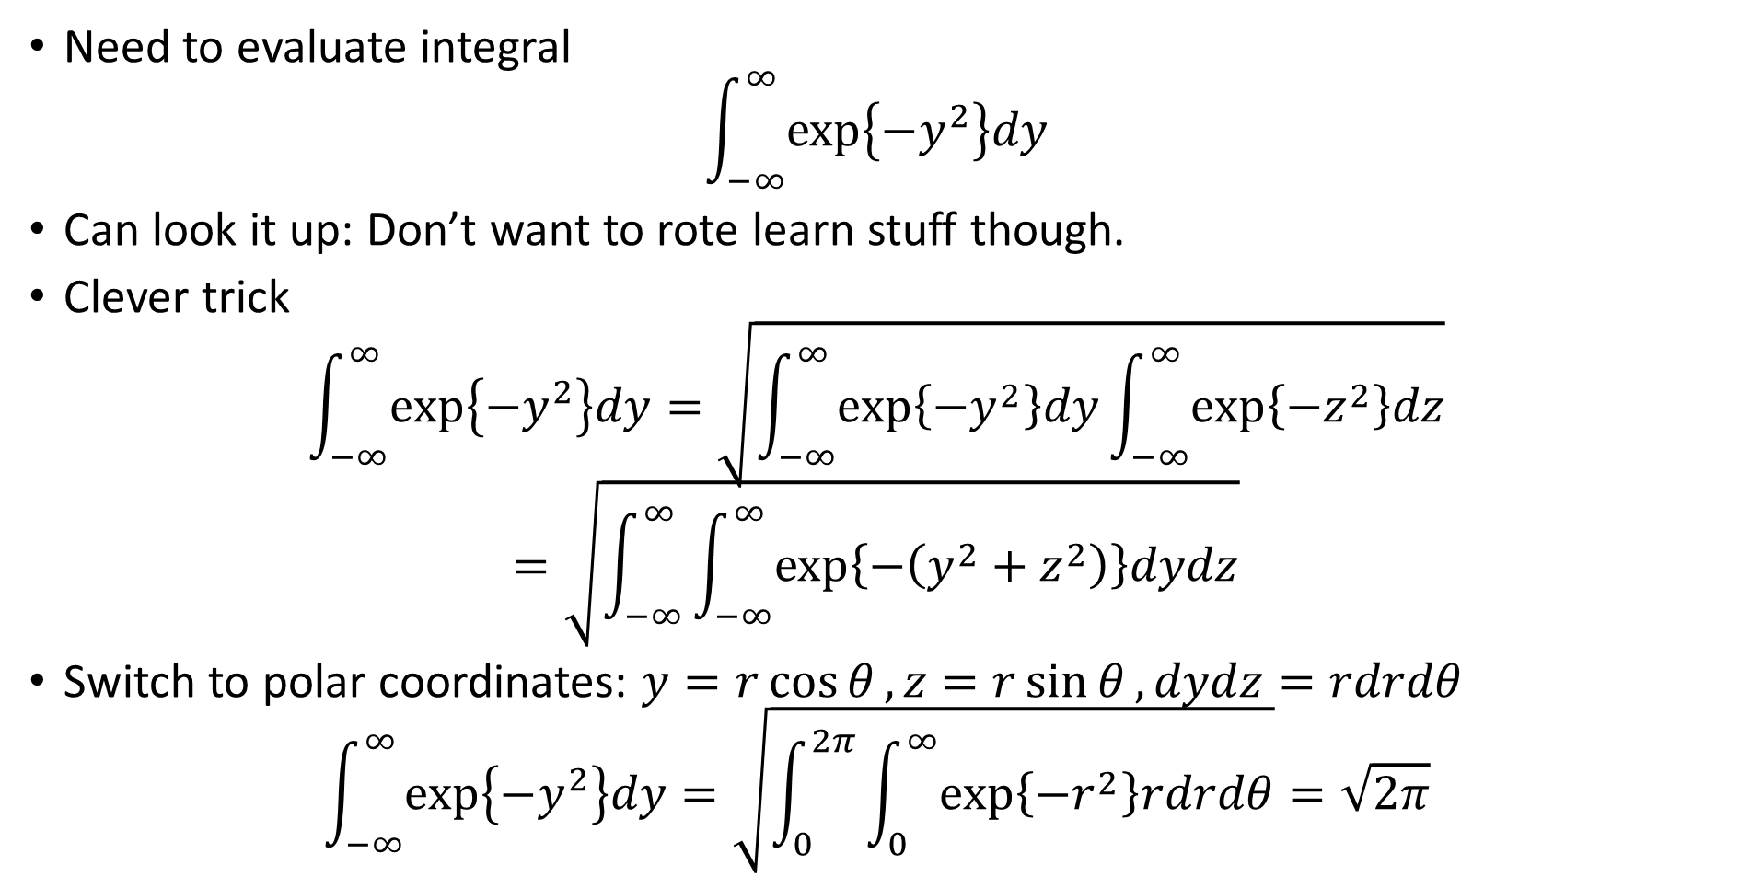
An Aside
Need to evaluate integral
$$\int_{−∞}^{∞}{\exp\left\{−y^{2}\right\}dy}$$
Can look it up: Don’t want to rote learn stuff though.
Clever trick
$$\int_{−∞}^{∞}{\exp\left\{−y^{2}\right\}dy}=\sqrt{\int_{−∞}^{∞}{\exp\left\{−y^{2}\right\}dy}\int_{−∞}^{∞}{\exp\left\{−z^{2}\right\}dz}}$$
$$=\sqrt{\int_{−∞}^{∞}{\int_{−∞}^{∞}{\exp\left\{−\left(y^{2}+z^{2}\right)\right\}dydz}}}$$
Switch to polar coordinates: $y=r\cos{θ}, z=r\sin{θ}, dydz=rdrdθ$
$$\int_{−∞}^{∞}{\exp\left\{−y^{2}\right\}dy}=\sqrt{\int_{0}^{2π}{\int_{0}^{∞}{\exp\left\{−r^{2}\right\}rdrdθ}}}=\sqrt{2π}$$

Slide 11
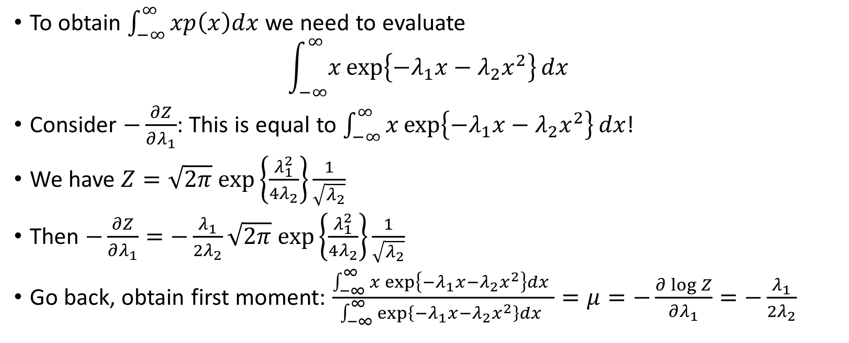
The First Moment
To obtain $\int_{−∞}^{∞}{xp\left(x\right)dx}$ we need to evaluate
$$\int_{−∞}^{∞}{x\exp\left\{−λ_{1}x−λ_{2}x^{2}\right\}}dx$$
Consider $−\frac{∂Z}{∂λ_{1}}$: This is equal to $\int_{−∞}^{∞}{x\exp\left\{−λ_{1}x−λ_{2}x^{2}\right\}}dx$!
We have $Z=\sqrt{2π} exp\left\{\frac{λ_{1}^{2}}{4λ_{2}}\right\}\frac{1}{\sqrt{λ_{2}}}$
Then $−\frac{∂Z}{∂λ_{1}}=−\frac{λ_{1}}{2λ_{2}}\sqrt{2π} exp\left\{\frac{λ_{1}^{2}}{4λ_{2}}\right\}\frac{1}{\sqrt{λ_{2}}}$
Go back, obtain first moment: $\frac{\int_{−∞}^{∞}{x\exp\left\{−λ_{1}x−λ_{2}x^{2}\right\}}dx }{\int_{−∞}^{∞}{\exp\left\{−λ_{1}x−λ_{2}x^{2}\right\}}dx }=μ=−\frac{∂\log{Z}}{∂λ_{1}}=−\frac{λ_{1}}{2λ_{2}}$

Slide 12
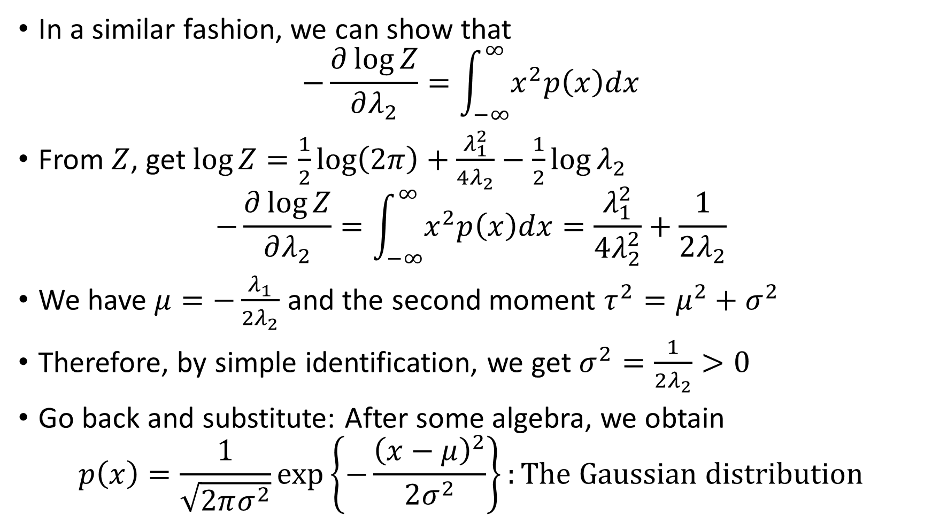
The Second Moment
In a similar fashion, we can show that
$$−\frac{∂\log{Z}}{∂λ_{2}}=\int_{−∞}^{∞}{x^{2}p\left(x\right)dx}$$
From $Z$, get $\log{Z}=\frac{1}{2}\log\left(2π\right)+\frac{λ_{1}^{2}}{4λ_{2}}−\frac{1}{2}\log{λ_{2}}$
$$−\frac{∂\log{Z}}{∂λ_{2}}=\int_{−∞}^{∞}{x^{2}p\left(x\right)dx}=\frac{λ_{1}^{2}}{4λ_{2}^{2}}+\frac{1}{2λ_{2}}$$
We have $μ=−\frac{λ_{1}}{2λ_{2}}$ and the second moment $τ^{2}=μ^{2}+σ^{2}$
Therefore, by simple identification, we get $σ^{2}=\frac{1}{2λ_{2}}>0$
Go back and substitute: After some algebra, we obtain
$$p\left(x\right)=\frac{1}{\sqrt{2πσ^{2}}}\exp\left\{−\frac{{\left(x−μ\right)}^{2}}{2σ^{2}}\right\}:The Gaussian distribution$$

Slide 13
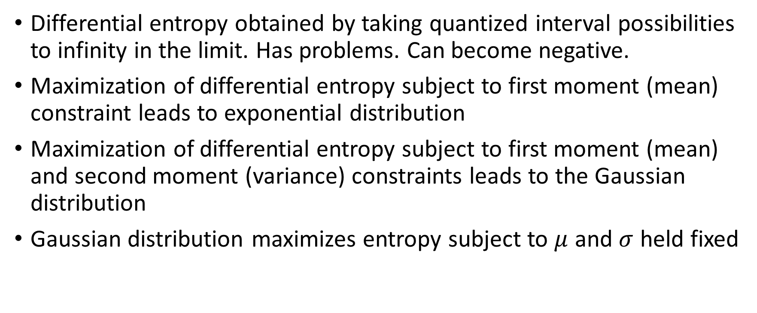
Summary
Differential entropy obtained by taking quantized interval possibilities to infinity in the limit. Has problems. Can become negative.
Maximization of differential entropy subject to first moment (mean) constraint leads to exponential distribution
Maximization of differential entropy subject to first moment (mean) and second moment (variance) constraints leads to the Gaussian distribution
Gaussian distribution maximizes entropy subject to $μ$ and $σ$ held fixed

